Slide 1



Thesis presented to the School of Technology and Management in the scope of the Master in Information Systems.
Almond Variety Detection using Deep Learning
Realised by :
Benarous Ahmed Omar Farouq A41369
Advisors:
Prof. Maria João Tinoco Varanda Pereira
College year: 2019/2020

Slide 2
Plan of the presentation
Introduction
Data collection and Pre-proccessing
Model implementation and deployment
Conclusion

Slide 3
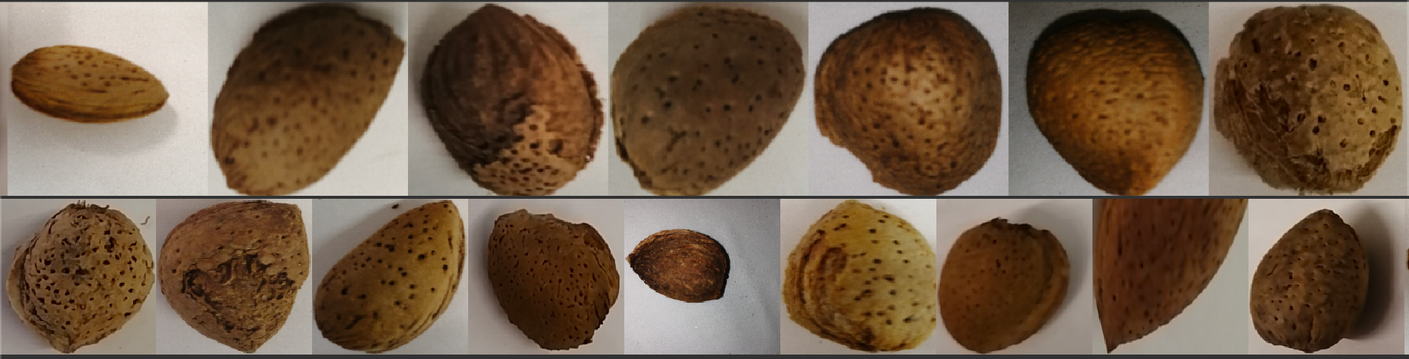






Introduction
Problem That we are tackling ?
Material Used ?
Usefulness of the solution ?
Figure 3.2

Slide 4
Introduction
State of the art ?
Autistic Based Classification
(Paper by by Simin Khalesi , Asghar Mahmoudi and Hosainpour Adel)
Almonds classification using supervised learning methods
(paper published by Elila Halac, Emir Sokic, Emir Turajlic from the Faculty of Electrical Engineering Sarajevo )

Slide 5
Introduction
Data
Why do we need data
Data collection
Why data pre-processing
That's how all primates works
Messy data
Remove uneeded dimensions
Label the data since we are using supervised model
Save us training time ,better generalisation

Slide 6
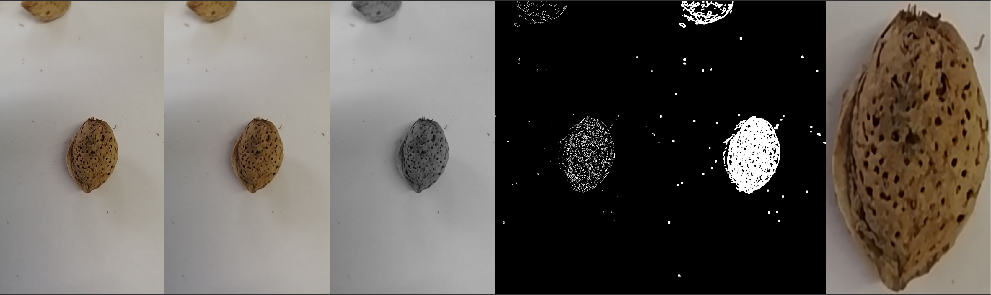
Introduction
Data
Steps of data proccesing
Bluring the image (Gussian)
Graying the Image
Edge and Shape detection using Canny Dilation
Find the contours
Corp the image
Figure 3.4

Slide 7
Introduction
Data
Model
Model Implementation
Iterations
Iteration 1 | Iteration 2 | Iteration 3
RGB based with Fully Connected Dense Network | Image based with Fully Connected Dense Network | Image Based with AlexNet V1
41 Trainble parameter | 700493828 parameter | 5 convolutional 3 dense 2 pooling
45 % | 67 % | 89 %
Iteration 4
Image Based with AlexNet V2
2 convolutional 1 pooling 2 dense
94 %

Slide 8
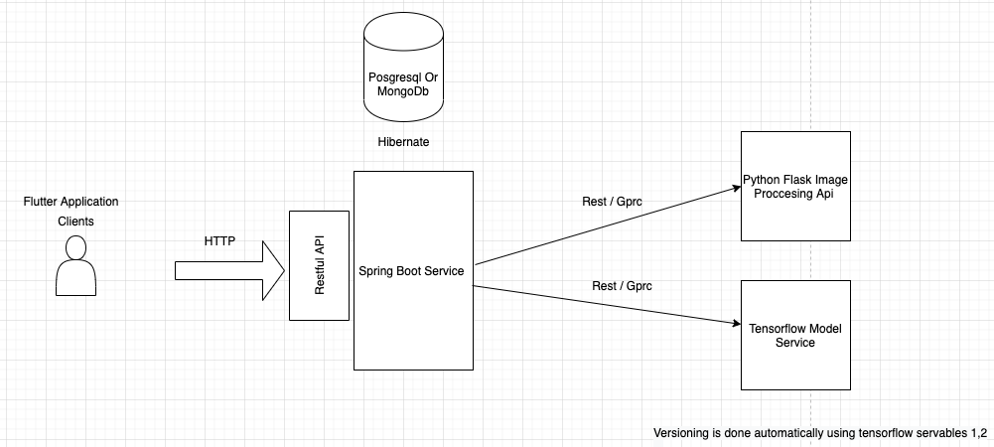
Introduction
Data
Model
Model Deployment (SAS)
Figure 5.3

Slide 9
Introduction
Data
Model
Conclusion
Usefulness of the solution
Supply chain optimization : AI in food manufacturing helps to monitor every stage of the process it makes price and inventory management predictions and tracks the path of goods from where they are grown to the place where consumers receive it (anomaly detection , classification choose the right machines)
Sorting food: optical sorting solutions Previously, a manufacturer had to hire many people to perform the monotonous and routine actions linked to food selection. Now, instead of manually sorting large amounts of food by size and shape (so that it can be canned or bagged)
Matching customer tastes with your business strategy: the idea is to use historical data to know better each client and their needs. Providing service and goods that match completely the taste and the needs of each client will improve the business.

Slide 10
Introduction
Data
Model
Conclusion
Further work
Potential Software Features
Potential Model Features
Add more features on the main app (auth , store previous infrences .. )
Load balancers
Caching layer Redis
Infer from different models at the same time at use the average of them all (meta learning)
Automatic Training with user feedback
Repurpose the model for similar issues (olives , add other type of almonds … )
Improve image processing by changing static values that we set to more dymanic ones (Canny thresh-hold or the blur kernel size …)
Multiple detection at the time (Introduce region proposal techniques)

Slide 11
Thank you for your attention

